Slide 1
Coastal Erosion Hazard Detection
Team: EASy - Hazard Detection

Slide 2
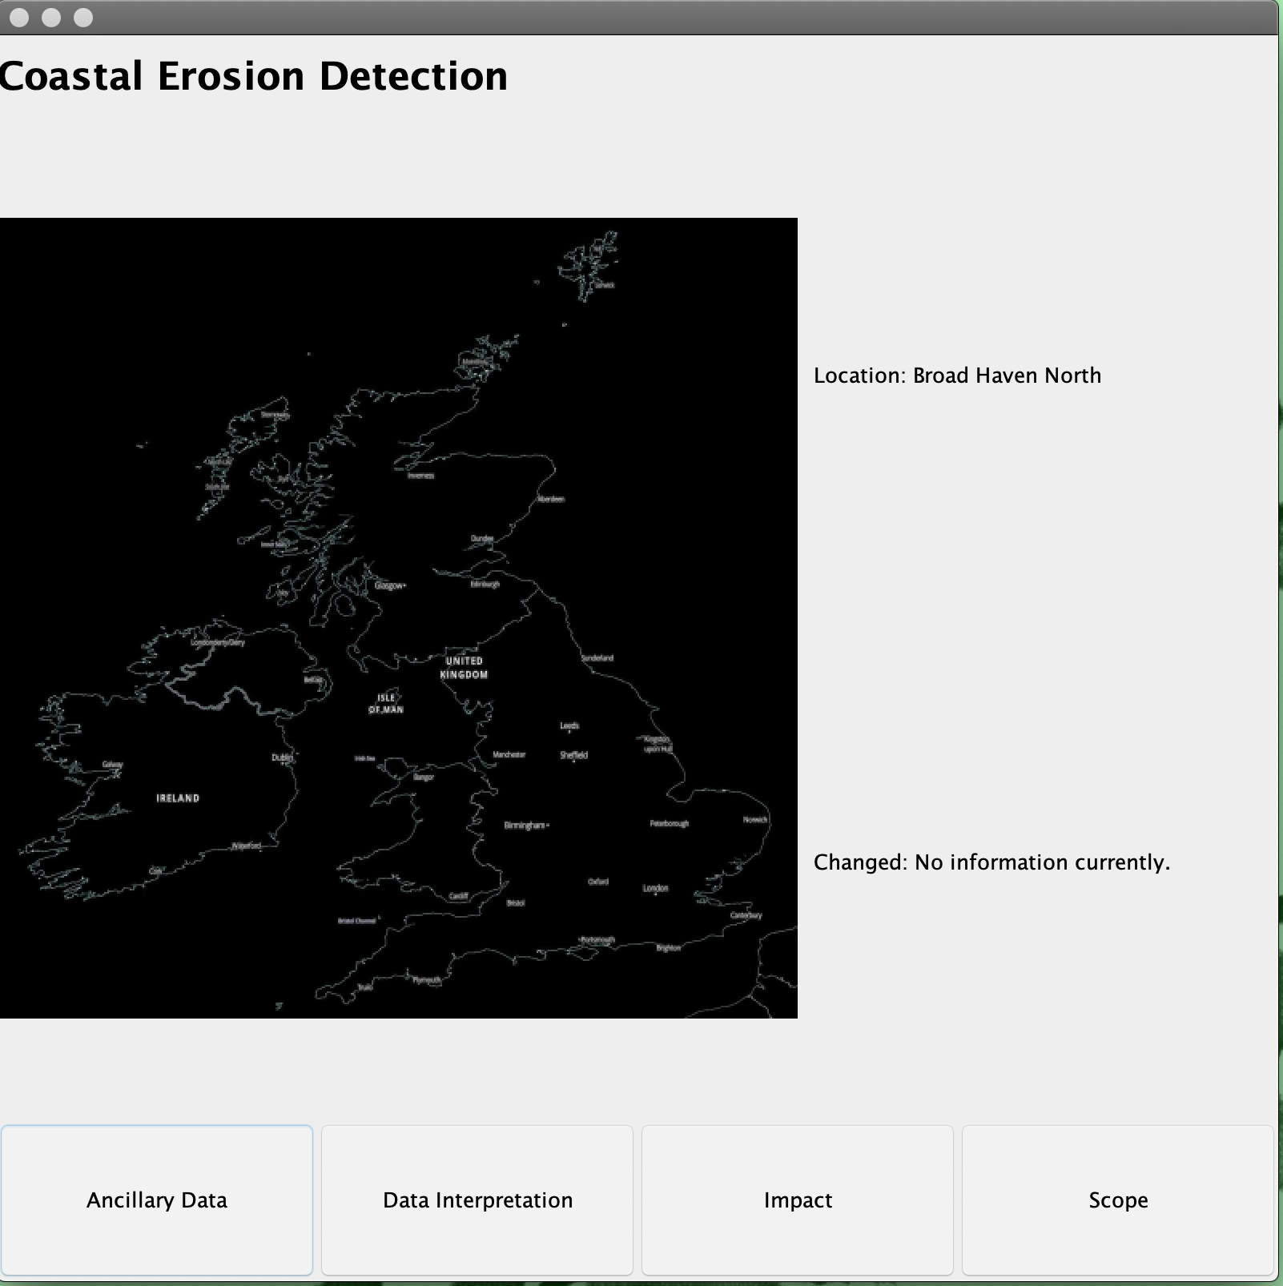
Main Interface This shows the initial photo where the hazard was detected. As well as key information to the side.

Slide 3
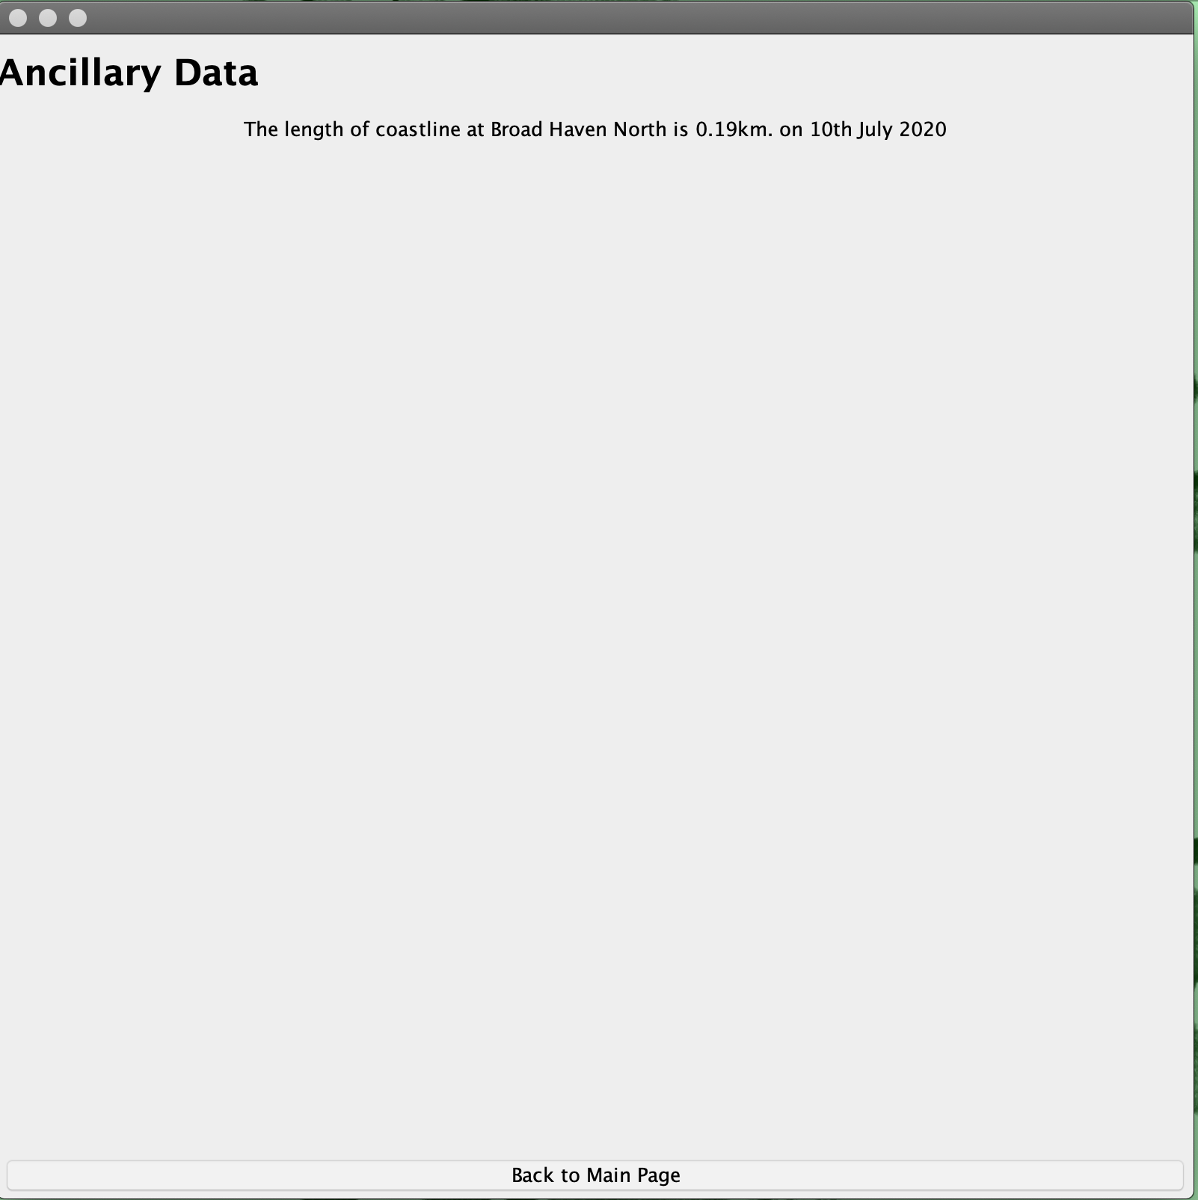
Ancillary Data Interface This shows the data which allowed the hazard to be detection.

Slide 4
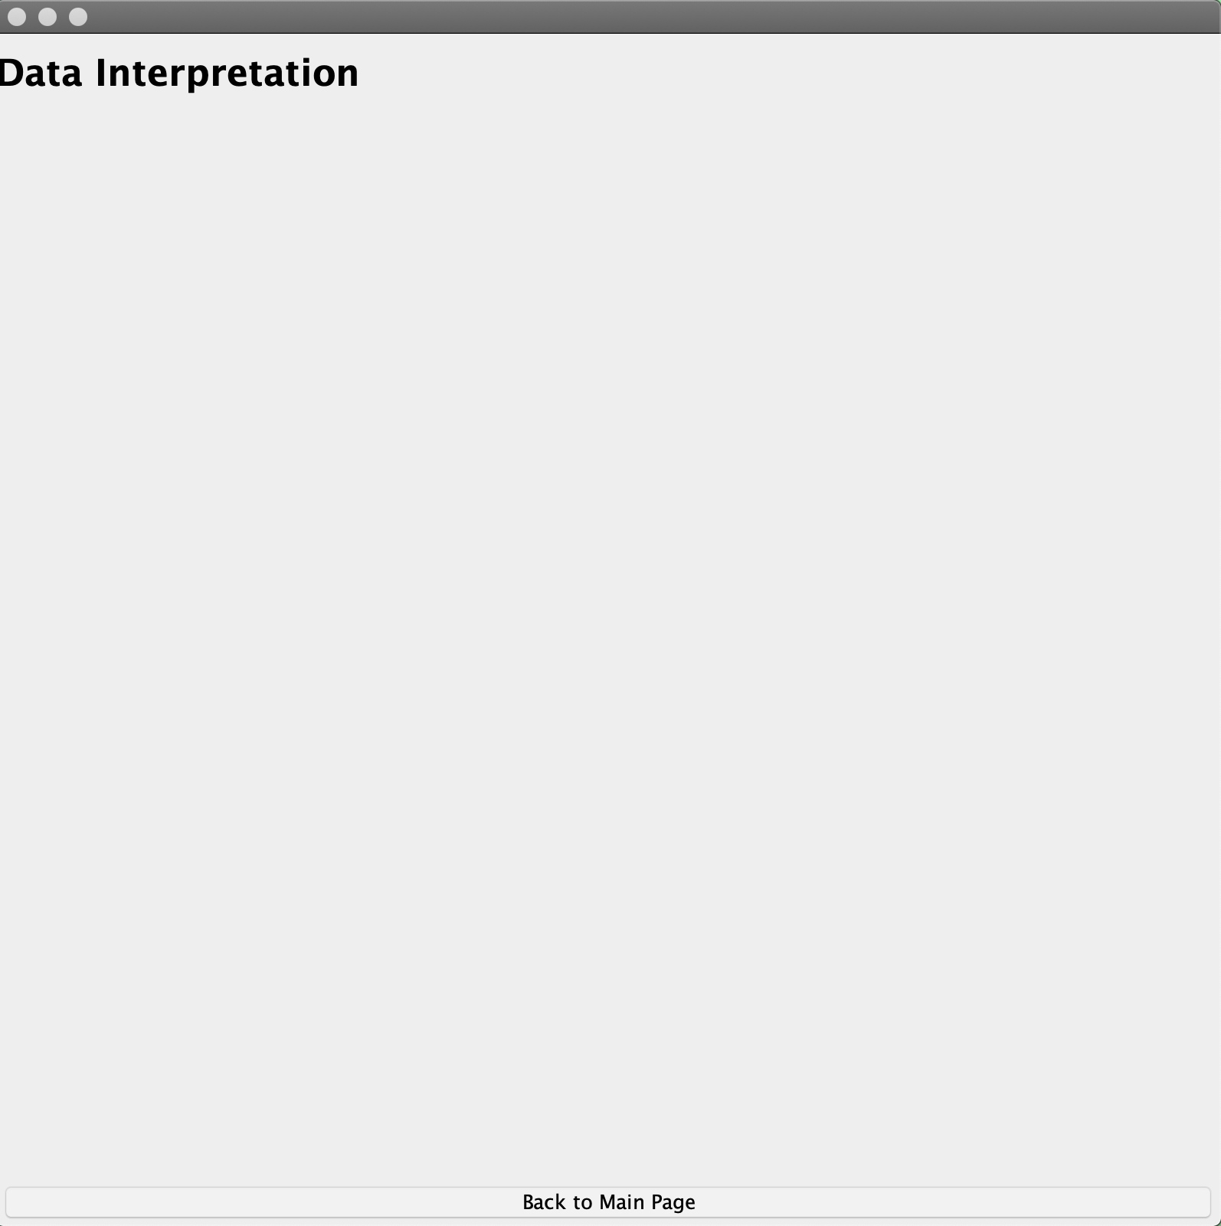
Data Interpretation Interface

Slide 5
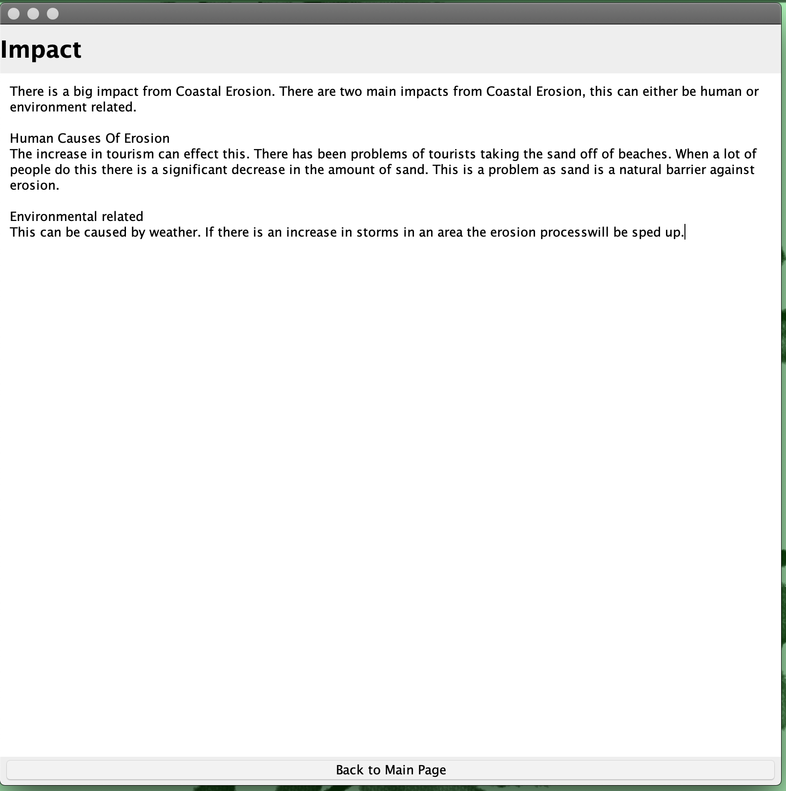
Impact Interface This describes where the impact for the coastal erosion is coming from.

Slide 6
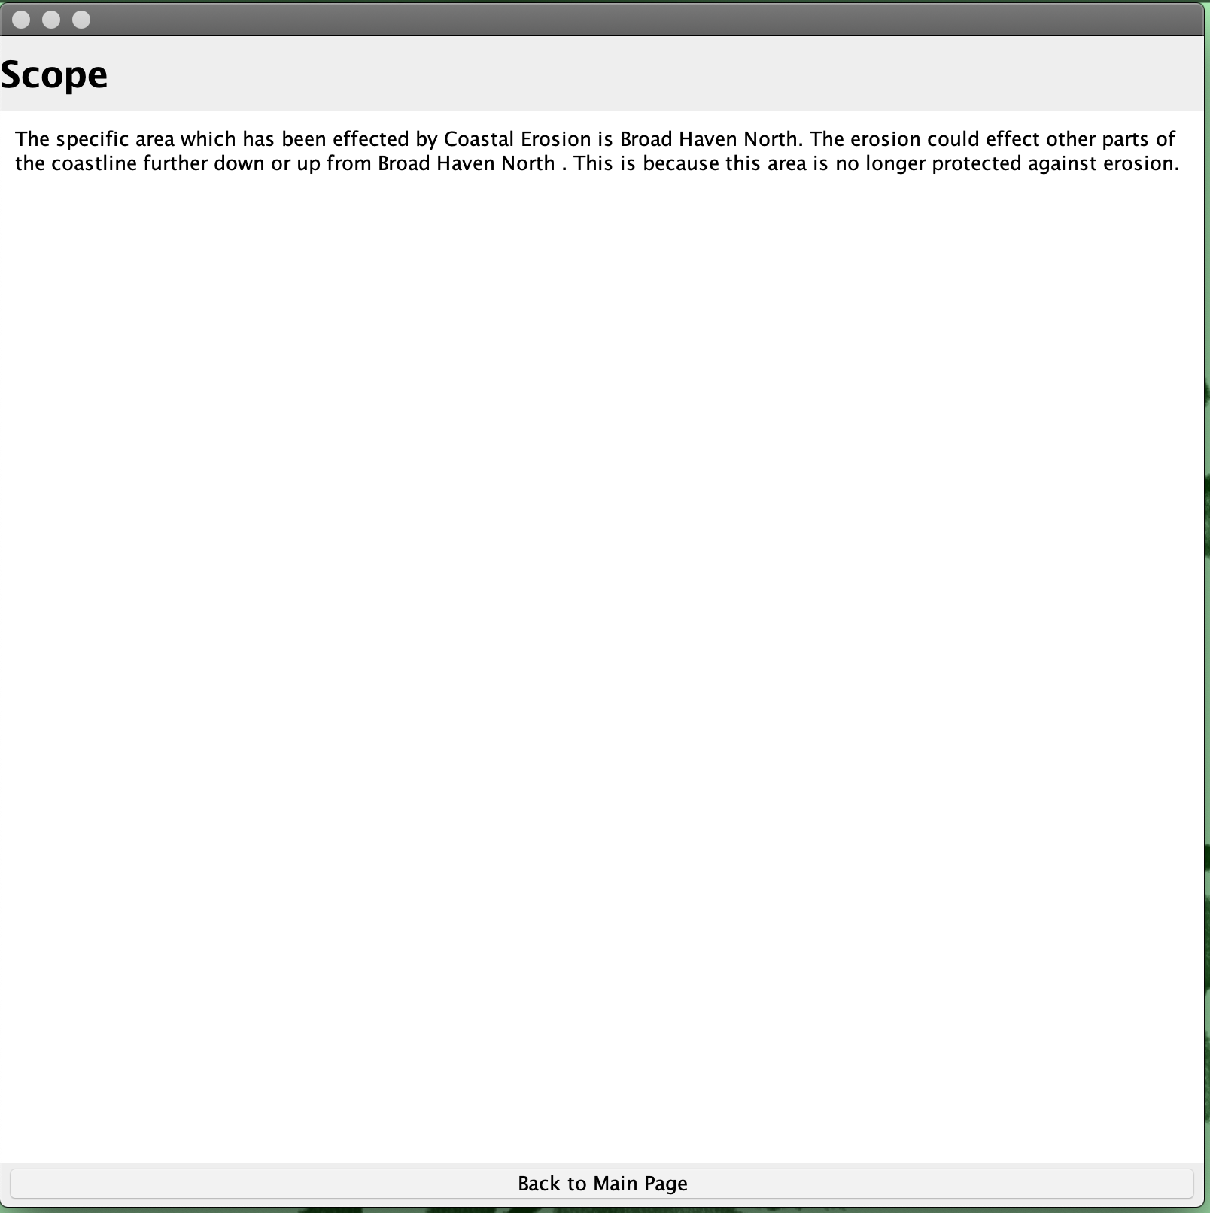
Scope Interface This describes how the erosion will effect the greater area.

